Slide 1
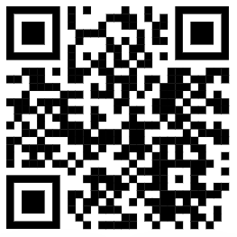
Maths
Year 7 Knowledge Organiser
Half Term 5 and 6
Topics covered during lessons
How to access Sparx:
Topic | Sparx Code
Using a ruler | M985
Using a pair of compasses | M196
Constructing Triangles | M565
Types of Angles | M502
Measuring angles | M780
Shape properties | M276
Angles on a line and about a point | M818
Angles in triangles | M351
Angles in quadrilaterals | M679
Angles on parallel lines | M606
Angles in polygons | M653
Subtracting Integers | M347
Subtracting Decimals | M152
Adding Decimals | M429
Scan QR code above
Select ‘Log in’
Select ‘Student log in’
Either use Sparx username/password or ‘Sign in using Microsoft’ option using school email address and password

Slide 2
Maths
Year 7 Knowledge Organiser
Half Term 5 and 6
Topics covered during lessons
How to access Sparx:
Topic | Sparx Code
Using a written method to multiply integers | M187
Using a written method to multiply decimals | M803
Adding and subtracting fractions | M835
Adding and subtracting mixed numbers | M931
Venn diagrams with set notation | M834
Using probability phrases | M655
Writing probabilities as fractions | M941
Writing probabilities as fractions, decimals, percentages | M938
Sample space diagrams | M718
Probabilities of mutually exclusive events | M755
Scan QR code above
Select ‘Log in’
Select ‘Student log in’
Either use Sparx username/password or ‘Sign in using Microsoft’ option using school email address and password

Slide 3
Maths
Year 7 Knowledge Organiser
Half Term 5 and 6
Topics covered during lessons
How to access Sparx:
Topic | Sparx Code
Finding factors and using divisibility tests | M823
Finding the lowest common multiple | M227
Finding the highest common factor | M698
Finding prime numbers | M322
Scan QR code above
Select ‘Log in’
Select ‘Student log in’
Either use Sparx username/password or ‘Sign in using Microsoft’ option using school email address and password

Slide 4
Forgotten your Sparx login details?
Scan QR code
Select ‘Log in’
Select ‘Student log in’
Select ‘Forgotten Sparx login details?’
Enter your name and date of birth
You will be given your username, and Sparx will generate a request with your teacher to allow you to reset your password.
Reset your password and continue with Sparx!

